Slide 1
Title IX
Title IX
This training is a brief summary of Rose-Hulman’s Title IX Policy and Procedures. The full policy and procedures can be found here.

Slide 2
Background of Title IX on Campus

Slide 3
What is Title IX
Title IX is a federal civil rights law passed as part of the Education Amendments of 1972. This law protects people from discrimination based on sex in education programs or activities that receive Federal financial assistance. Title IX states:
“No person in the United States shall, on the basis of sex, be excluded from participation in, be denied the benefits of, or be subjected to discrimination under any education program or activity receiving Federal financial assistance.”
Title IX regulations recognize that sexual harassment, including sexual assault, is unlawful sex discrimination.

Slide 4
Conditions… Formal Title IX Complaint
The following conditions must be met to qualify for a formal Title IX Complaint.
  The conduct must meet the legal definition of “sexual harassment.”
  The conduct must occur within the context of an “educational program or activity” for which the Institute has jurisdiction over the Respondent.
  The conduct must occur in the United States.
  The Complainant must be a student at Rose or attempting to attend Rose.
The Title IX Coordinator is required to dismiss the reported grievance if allegations do not meet Title IX conditions.
However, dismissal does not preclude action under other policies such as student conduct, faculty handbook, staff handbook etc.

Slide 5
Mandatory Reporters
  Students have a choice! Federal guidelines encourage schools to respect the autonomy of Complainants to allow them some control over when and if alleged sexual harassment is reported and investigated.
  If a student or employee chooses to inform any of the following mandatory reporters of allegations of sexual harassment, the mandatory reporter must report the allegations to the Title IX Coordinator.
    The Title IX Coordinator
    Vice President of Student Affairs and Dean of Students
    Vice President for Human and Environmental Services
    The Ombudsperson Committee
    All employees in a supervisory role are mandatory reporters of complaints made by employees under their supervision.

Slide 6
When A Report is Received
Upon receiving notice of an alleged sexual harassment, the Title IX Coordinator will:
Contact the Complainant to discuss the availability of supportive measures.
Consider the Complainant’s wishes with respect to supportive measures.
A student may receive supportive measures irrespective of whether the student files a formal complaint which encourages students to report sexual harassment while allowing them to exercise some control over their report.
Explain to the Complainant the process of filing a Formal Complaint.

Slide 7
Supportive Measures
  Examples of Supportive Measures include, but are not limited to:
    Consultation with Public Safety or local law enforcement
    Rescheduling academic assignments or tests
    Moving to another course section
    Adjusting housing arrangements
    Referral to counseling or other health services
    Mutual No Contact Orders
  The Complainant can choose to accept or not accept supportive measures.
  Supportive measures are free of charge.
  Respondents in a formal complaint/investigation also receive supportive measures.

Slide 8
Filing a Formal Complaint
A formal complaint is REQUIRED by federal law before Rose-Hulman can investigate an allegation of sexual assault.
If a student informs us of an incident, but chooses to not file a formal complaint, in most circumstances we cannot proceed.
The Title IX Coordinator can sign a complaint and initiate an investigation. However, we will only do that if there is a serious threat to the safety of the campus community. We will not force a complaining party to engage in the process, except under extreme circumstances.

Slide 9
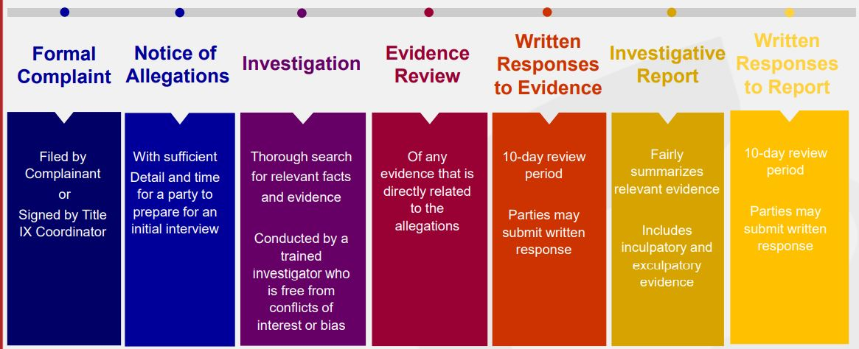
Investigation Requirements

Slide 10
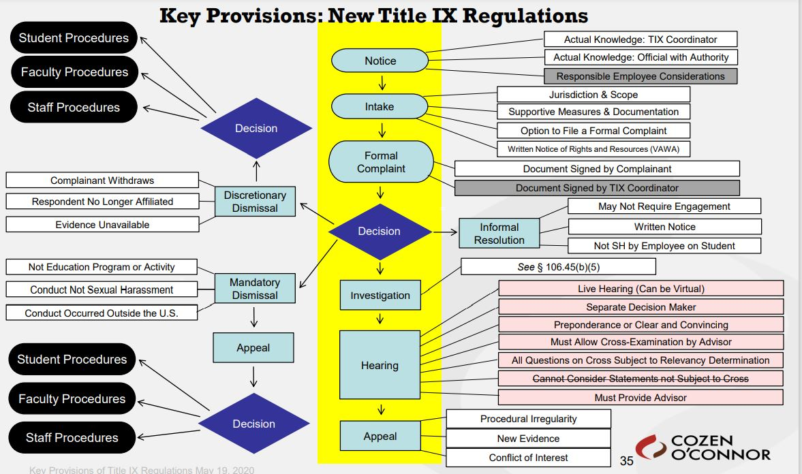
Title IX Procedure

Slide 11
Basic Requirements of the Investigation
  Interview Complainant and Respondent – these interviews typically last one to two hours
  Identify all possible witnesses – eyewitnesses, friends, and roommates
  Interview all possible witnesses
  Gather additional evidence – text messages, social media, campus video surveillance, ID access records
  Follow-up interviews

Slide 12
Basic Requirements of the Investigation
  The typical case includes at least 6-10 interviews.
  We have interviewed as many as 30 students for one investigation.
  Under the current process, Kristen and Holly conduct all interviews together. Detailed notes of each interview are taken, and most interviews are recorded with student permission.
  Discuss and evaluate. Do we need more information? Are there other people to interview? Has new evidence surfaced that we need to request?

Slide 13
Alcohol: Investigative Challenges
  Lack of memory
  Inability to give detail
  Person may have been unconscious or in and out of consciousness
  Delay in reporting because:
    May not know the event occurred
    May not recognize it as lack of consent
    Feeling of “contributory negligence”
    Concerns over conduct policy consequences
  Delays in reporting create challenges for the investigation. We may be asking a student about events that occurred more than a year prior and while they were intoxicated.

Slide 14
Get Detailed Information
  Timeframe of consumption (first drink, last drink, spacing)
  Number of drinks
  For each drink:
      Type (beer, wine, liquor – specific brand if possible)
      Was it mixed with anything? Who mixed it?
      How was it served?
  List of others present and when they were there
  Behaviors of parties that may help evaluate intoxication vs. incapacitation
  Other factors that affect impact of alcohol:
      Food consumed before, during, and after the alleged incident, height and weight, medications, different sleep patterns, illness, low hydration, history of blackout.

Slide 15
Get Detailed Information
  Other information that can establish timeline, assist in assessing level of impairment, and can provide corroboration of either party’s account:
      History of relationship between the parties
      Witness’s knowledge of Complainant’s sober behavior
      Parties’ communications or interactions with each other (compare pre- and post-incident)
      Parties’ descriptions of the incident to others – context, content, demeanor
      Text/social media messages sent before, during, and after the incident

Slide 16
Gathering Evidence and Creating Investigative Report
  The burden of proof and the burden of gathering evidence rests on Rose-Hulman and not on the parties.
  Our goal in these investigations is not to prove or disprove that something occurred. Our goal is to gather all possible evidence to increase the likelihood of finding the truth.
  The investigators prepare a report that summarizes all interviews and evidence gathered. These reports are typically 15-30 pages in length.
  The reports are provided to the parties, and they are given the opportunity to respond in writing. They often have private lawyers helping them through the process.

Slide 17
Investigative Report: Findings
  Final decisions on Title IX cases are made by Erik Hayes (for students) and Megan Elliott (for employees).
  For students, Erik reviews the report and determines whether he feels that any additional information is needed. He often conducts his own interviews with both students to ask additional questions.
  Erik meets with the students and lets them know his thoughts on the case. If the students agree with his conclusions, the case is resolved and closed.
  If the students disagree, they have a right to a full hearing and presentation of evidence.
  The majority of cases end without a hearing, by the choice of the students.

Slide 18
Preponderance of the Evidence
Various ways to describe the standard:
  More likely to be true than not.
  More probable than not.
  The greater the weight of the evidence.
  Tipping the scale ever so slightly.
  51%
The standard is NOT beyond a reasonable doubt or clear and convincing evidence – these are criminal standards.
There must be something to tip the scale. It must be more than the Complainant’s story vs. the Respondent’s story.

Slide 19
CHALLENGES TO TITLE IX
Alcohol – 90%+ of all cases
Private nature of incidents
Mental Health
Delay in Reporting

Slide 20
Challenges at Rose-Hulman
Misuse of terminology
Not understanding the definitions and parameters set forth by the OCR and DOE
Inability to defend the process due to FERPA and privacy concerns
Rumors, hearsay, game of “telephone”
Inaccurate and incomplete information

Slide 21
Challenges at Rose-Hulman
Be considerate of your friend’s privacy: do not share their story.
Know your resources and connect your friend to them.
Be supportive and not judgmental.
Remember, coming to Kristen or Kyle to talk and ask questions does not initiate an investigation *.
If you don’t know what to do, ask someone.
If you feel something is “off”, tell someone.
We cannot do anything about information we do not have.

Slide 22
FINAL THOUGHTS

